Slide 1

1. Ask from a user a number. And output its description string as: positive even number, positive odd number, negative even number, negative odd number and zero number.
Output:
Number | Output
34 | positive, even
177 | positive, odd
-114 | negative, even
-53 | negative, odd
0 | zero

Slide 2

2. Ask from a user a number in the range 1 to 99. And output its description string as: 1 digit even number, 1 digit odd number, 2 digit even number, 2 digit odd number.
Output:
Number | Output
6 | 1 digit even number
3 | 1 digit odd number
94 | 2 digit even number
43 | 2 digit odd number
<1 or 99< | I didn't understand

Slide 3
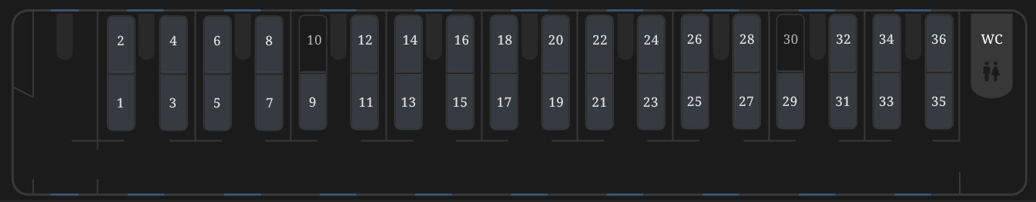
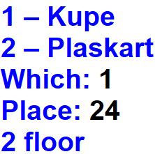
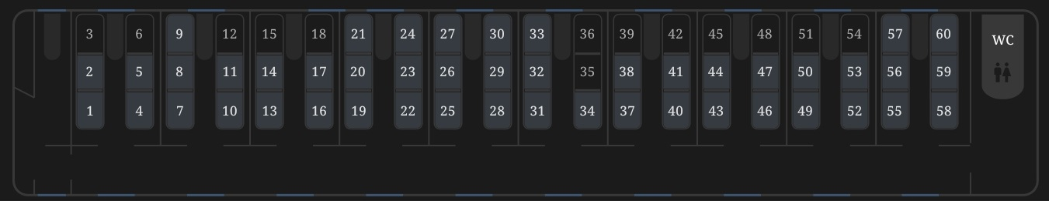
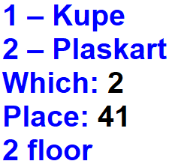
Problem-3:
Kupe
Output:
Plaskart
Output:

Slide 4


